Slide 1
OHM SWEET HOME
Weekly Update 1

Slide 2
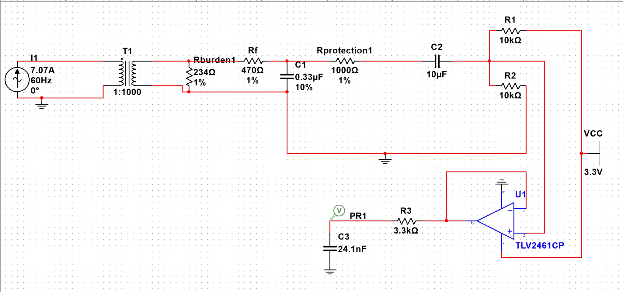
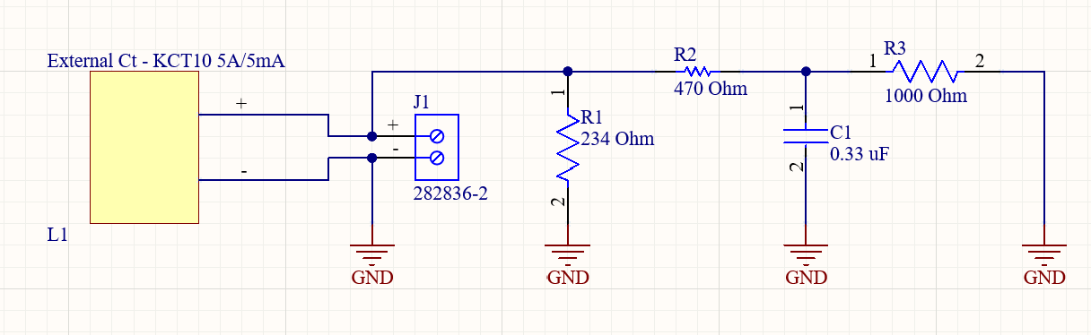
Sensor Front End and Signal Conditioning (Kim Peteros and Lawson Parr)
Completed:
Scaled down circuit from 200A to 5A max load input.
Component values finalized for scaled down circuit.
Circuit integration with Lawson completed and simulations verified.
In Progress:
Sensor Front End PCB redesign.
Full PCB integration with Signal Conditioning and Embedded Systems.

Slide 3
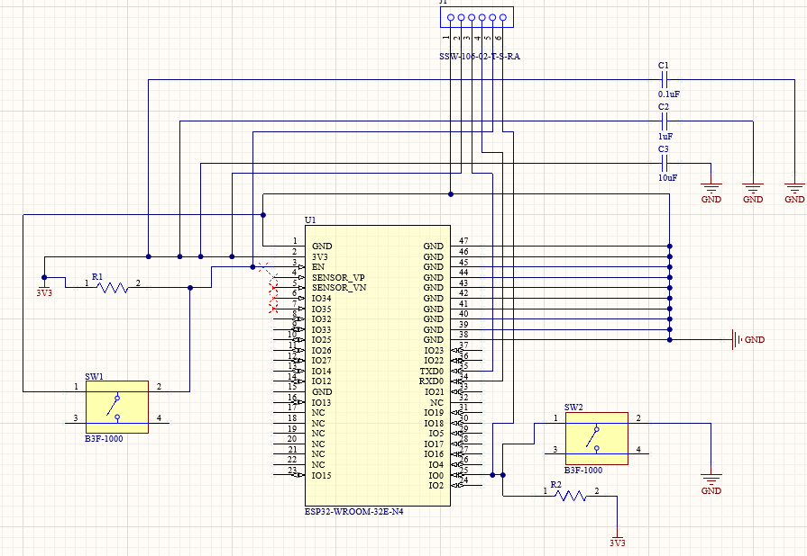
Embedded Systems (Caiden Rueben)
Completed:
Built the ESP32 MCU schematic with a regulated 3.3 V supply and proper decoupling for reliable operation.
Added reset, boot, and UART programming support to match ESP32 dev-kit behavior and ensure recoverability.
In Progress
Full schematic + PCB integration with Signal Conditioning and Sensor Front End
PCB Ordering

Slide 4
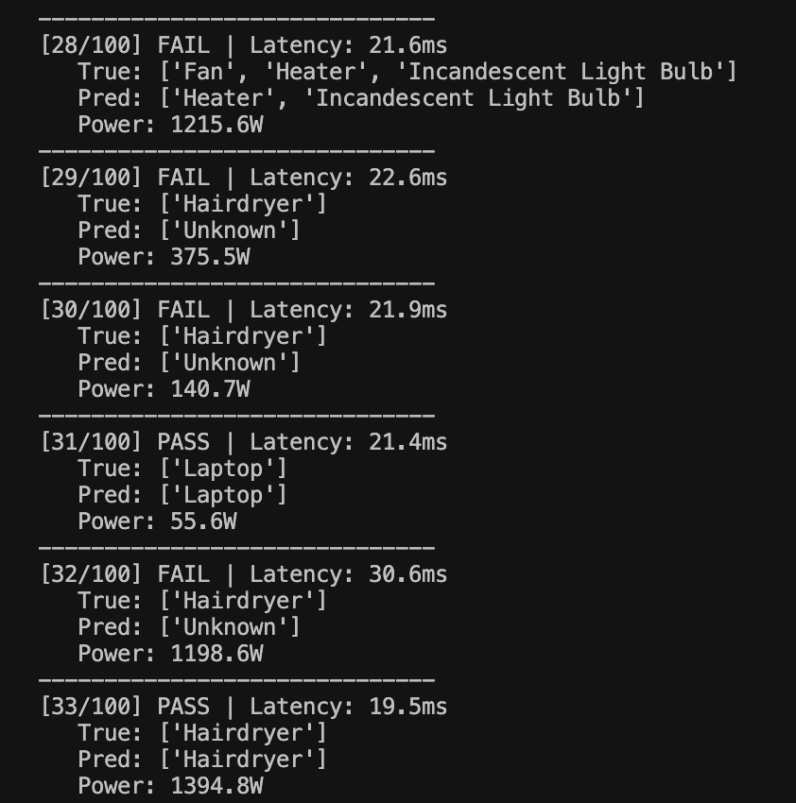
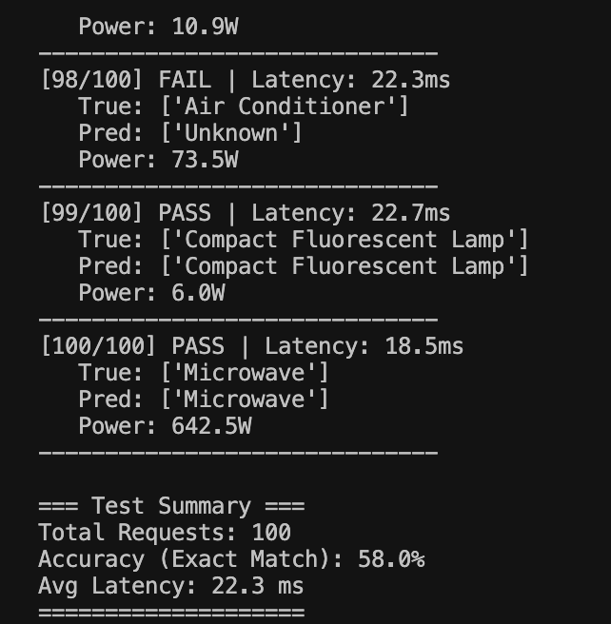
Machine Learning (Joshua Le)
Completed:
Finalized the cloud architecture: Google Cloud Run for the ML inference container
Refactored the Flask API for production use (clean /predict and /health endpoints, updated appliance power table, and total-wattage output).
Ran stress tests on synthetic multi-appliance mixes; currently around 60% exact-match accuracy with ~40 ms average latency.
In Progress
Deploy the existing Dockerized API to a test Cloud Run service and verify scaling/latency.
Build a “mock ESP32” Python client that streams synthetic frames to Cloud Run and writes predictions to Firebase so we can exercise the pipeline before the PCB arrives.

Slide 5
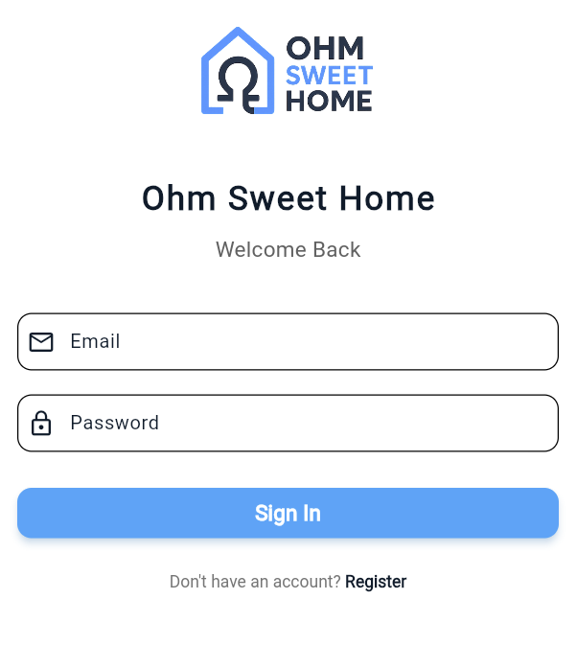
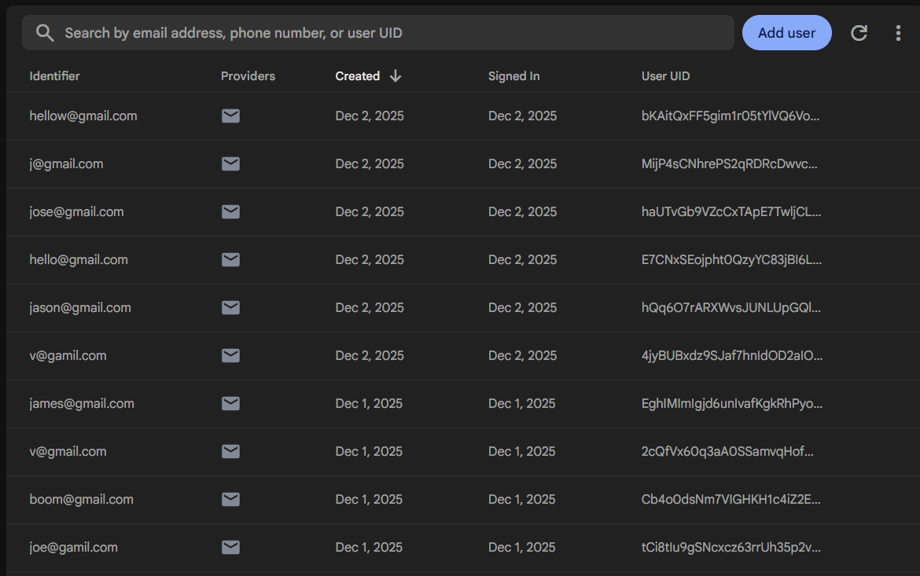
Application Development (Vivek Samuel)
Completed
Set up/fixed user authentication so users have an individual user id
In progress:
Working on the backfill algorithm and making sure the app works with the database.

